Slide 1
Operating Systems
Monitors

Slide 2
Monitors
A high-level abstraction that provides a convenient and effective mechanism for process synchronization.
Abstract data type, internal variables only accessible by code within the procedure
Only one process may be active within the monitor at a time

Slide 3
Monitors
Structure of Monitor
monitor monitor-name
{
// shared variable declarations
procedure P1 (…) { …. }
procedure Pn (…) {……}
Initialization code (…) { … }
}
}

Slide 4
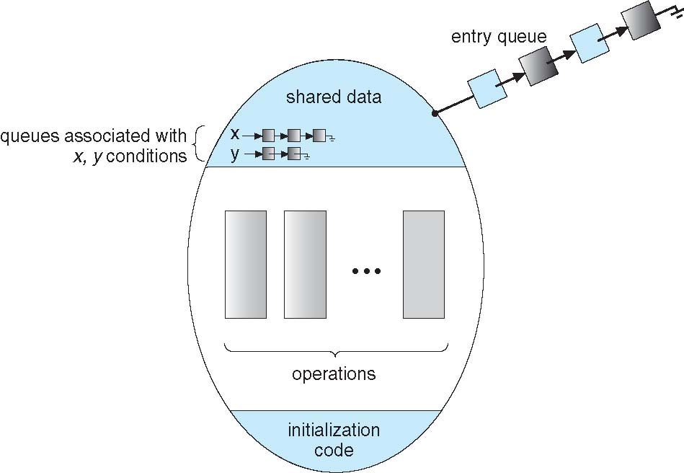
Monitors

Slide 5
Monitors
condition x, y;
Two operations are allowed on a condition variable:
x.wait() – a process that invokes the operation is suspended until x.signal()
x.signal() – resumes one of processes (if any) that invoked x.wait()
If no x.wait() on the variable, then it has no effect on the variable

Slide 6
Monitors – Dining Philosopher Problem
monitor DiningPhilosophers
{
enum { THINKING; HUNGRY, EATING) state [5] ;
condition self [5];
void pickup (int i) {
state[i] = HUNGRY;
test(i);
if (state[i] != EATING) self[i].wait;
}
void putdown (int i) {
state[i] = THINKING;
// test left and right neighbors
test((i + 4) % 5);
test((i + 1) % 5);
}

Slide 7
Monitors – Dining Philosopher Problem
void test (int i) {
if ((state[(i + 4) % 5] != EATING) &&
(state[i] == HUNGRY) &&
(state[(i + 1) % 5] != EATING) ) {
state[i] = EATING ;
self[i].signal () ;
}
}
initialization_code() {
for (int i = 0; i < 5; i++)
state[i] = THINKING;
}
}

Slide 8
THANK YOU

